Slide 1
Web Application for Abuse Report
Design Systems CS509
Professor Eric Hemdal

Slide 2

Team 2 Members- Roles
Chengjiao Yang(Ralph) – Developer
Mohammed Ayub – Project Lead, Database designer
Qiukun Lin(Lin1) – Tester, Functional Analyst
Rui Jin – Developer
Rundong Yu(James) – Meeting Organizer, Functional Analyst
Wenxin Zhao – Database Designer
Yichen Lin(Lin 2) – Designer

Slide 3
Tools Used
MySQL 5.6 – Database Design
MyEclipse 10 – Development
GitHub – Repository
Junit – Testing
Microsoft Project – Project Schedule
Ageerdo – Weekly Meetings

Slide 4
Risks and Surprises (Plan vs. Actual)
Change from Eclipse to Myeclipse 10
Data Security – HIPAA, SECTION 508, CMR 4.0
Estimation on Front End Design

Slide 5
Work products Generated
Requirement Document
Design Document
Traceability Matrix
Test Plan Document
Meeting Notes
Version Release Document
User Manual
Install notes

Slide 6
Interpersonal Challenges
Biggest of All Challenges
Conveying the Problem Statement to entire team
Brainstorming during weekly meetings.
Overcoming the Programming Challenge.

Slide 7
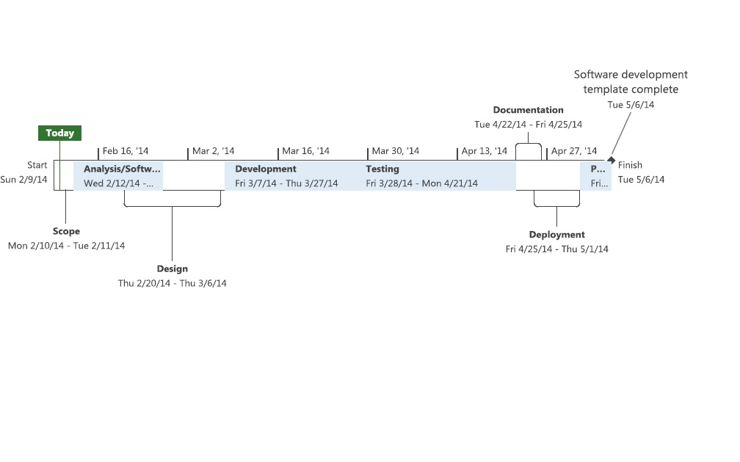
Where we stand..

Slide 8
Take Away…
Real World Project Experience
Project Management Skills
Working in a Culturally Diversified Team
Refresher on Programming Skills

Slide 9
Deliverables
Source Code
JUnit test Code
User Documentation
Install Notes
Requirement Document
System Design Document
Test Plan Document and Test Cases
Traceability Matrix
Software Setup Files
Minutes of Meeting

Slide 10
TEAM TALK..!!!

Slide 11
Thank You..!!!

